Slide 1

Unlocking Model Potential
The Model Context Protocol (MCP)
Technology Sharing Workshop
2024
AI/ML Engineers • Data Scientists • Product Managers
Interactive Session

Slide 2
Workshop Agenda

Slide 3
Workshop Overview
What We'll Cover Today
1
The Context Crisis
2
MCP Framework
Current AI limitations and their impact
Core components and methodology
3
Real-World Applications
4
Implementation Guide
Case studies and success stories
Tools, practices, and next steps

Slide 4
The Problem

Slide 5

The Challenge
The "Context Conundrum" in AI
Dynamic Scenarios
Missing Context
Models struggle with real-world complexity and changing environments
30-40% of AI errors stem from lack of situational awareness
Poor Experience
Irrelevant outputs lead to user frustration and costly retraining

Slide 6
Real-World Impact
When Context Goes Wrong
30-40%
<2%
Model errors from missing context
Conversion rates
Critical data about user state and environment
Generic recommendations without personalization
35%
Irrelevant responses
Chatbots losing conversation history
Examples: Chatbots forgetting conversation flow, recommendation engines suggesting out-of-stock items, models giving outdated advice

Slide 7
The Solution

Slide 8


Introducing
Model Context Protocol (MCP)
A systematic framework for acquiring, managing, and applying contextual data to enable AI models to make smarter, context-aware decisions
25%
4
Improvement in model accuracy
Core pillars
Define • Capture • Manage • Apply

Slide 9




MCP Framework
Four Core Pillars
Define
Capture
Structure relevant attributes and context requirements
Real-time data streams and sensor integration
Manage
Apply
Efficient storage, indexing, and versioning
Dynamic integration with model inference

Slide 10
Technical Deep Dive

Slide 11
Technical Implementation
MCP Components Explained
1
2
Context Definition
Context Capture
Structuring user profiles, device state, temporal data, and environmental variables
Real-time streams via Kafka/Kinesis, sensor fusion, API integrations
3
4
Context Management
Context Application
Vector databases, feature stores, efficient indexing and versioning systems
Dynamic prompt engineering, feature engineering, adaptive model selection

Slide 12
Case Studies

Slide 13
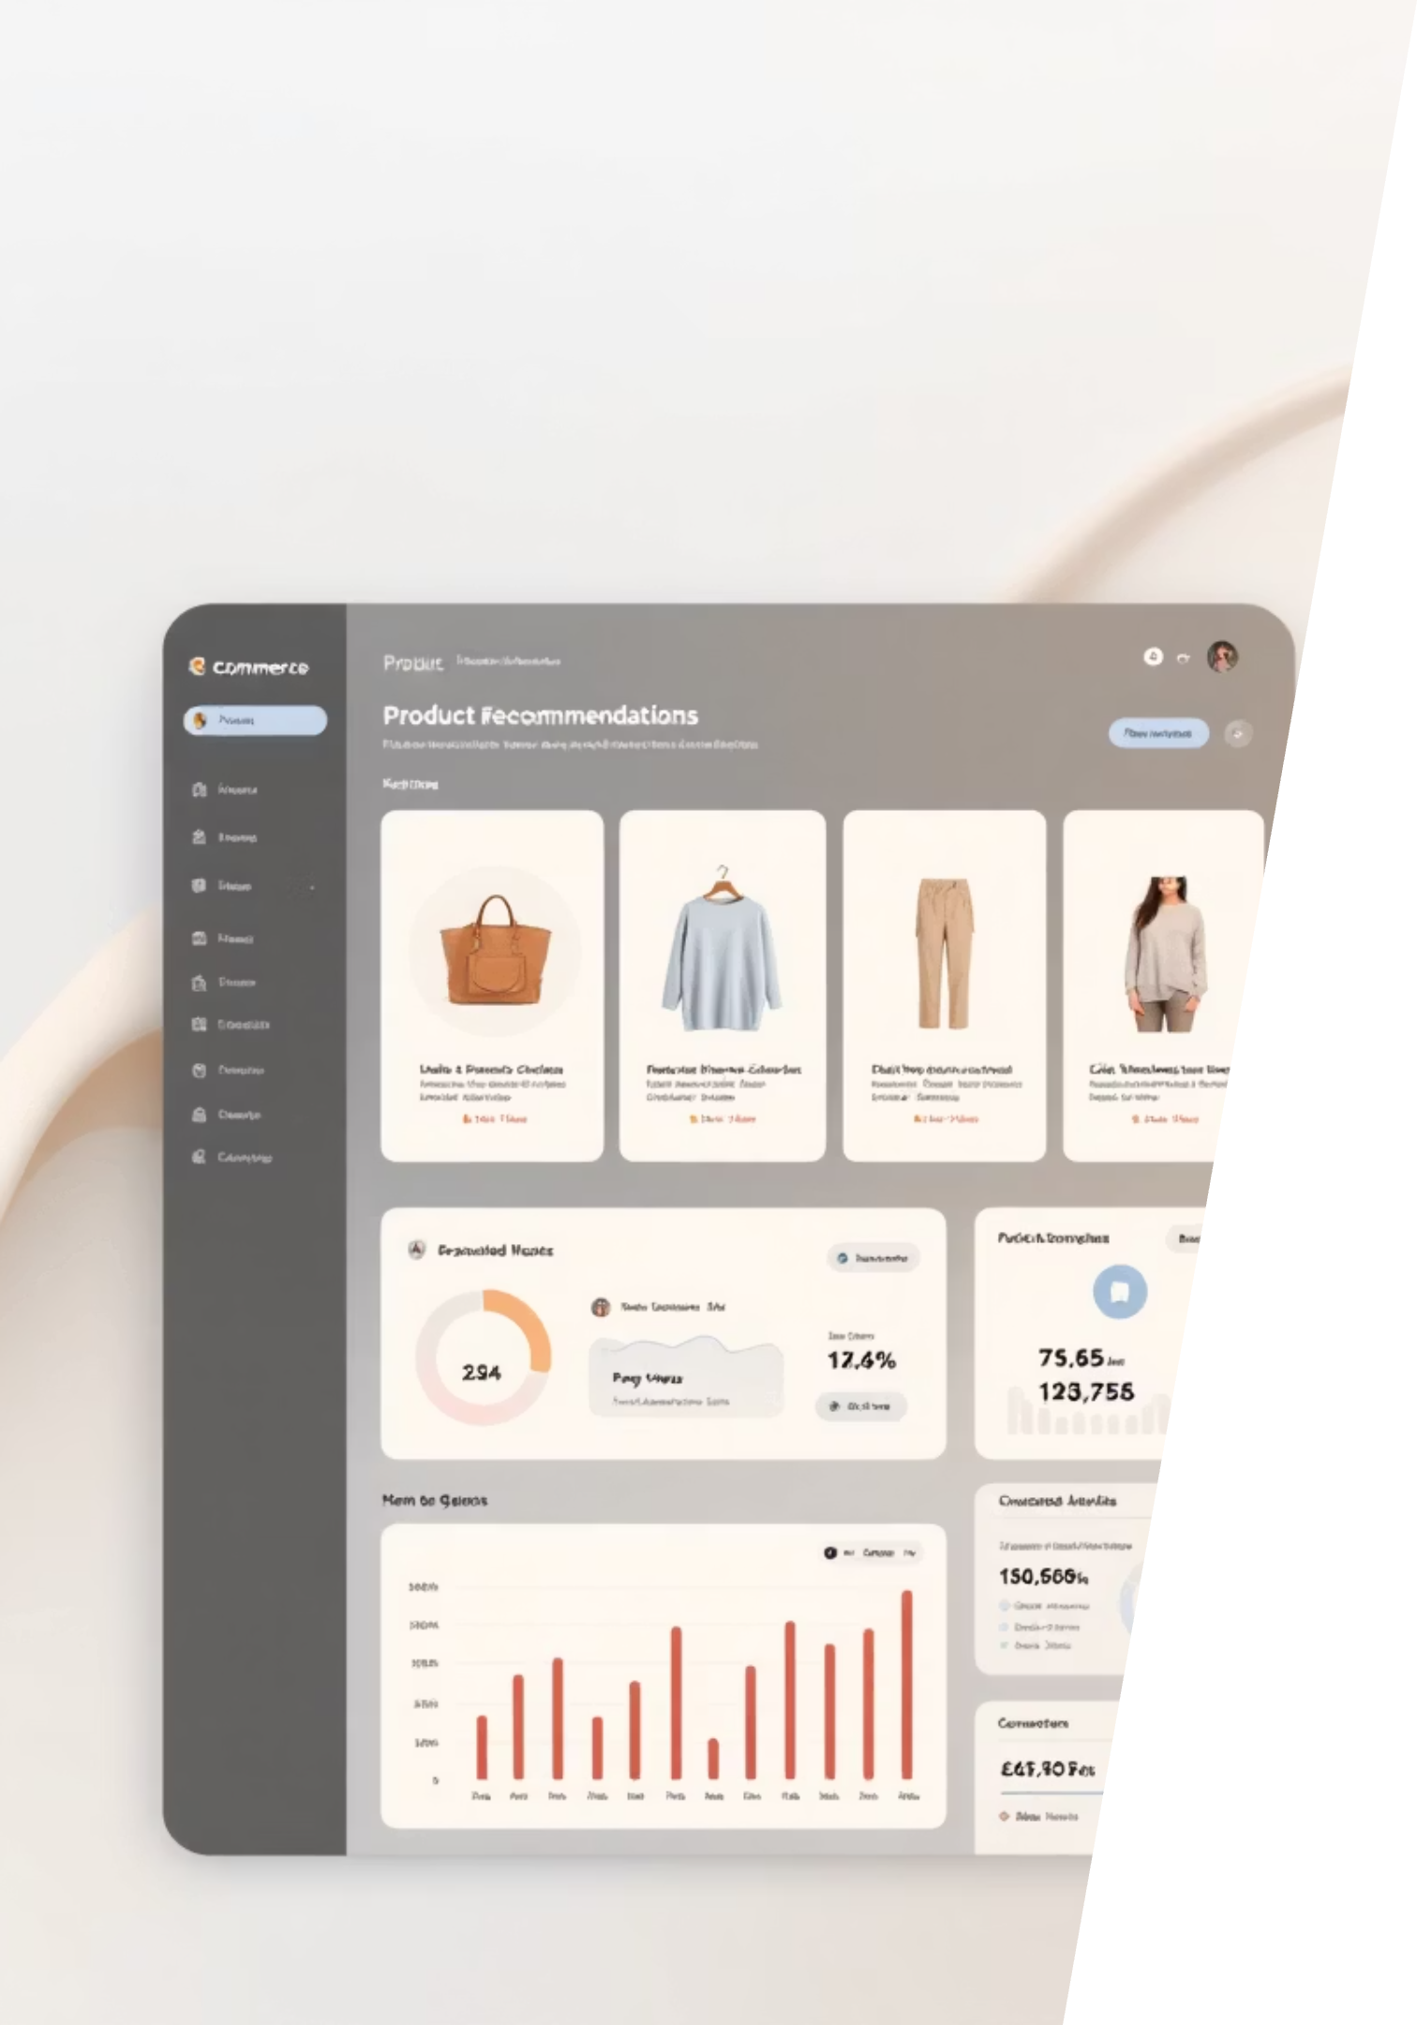
Case Study 1
Personalized E-commerce
Problem
Tech Stack
Generic product suggestions yielding <2% conversion rates
Apache Kafka for clickstreams
Redis for session state
Solution
ChromaDB for semantic context
Integrated real-time browsing data, localized inventory, user sentiment analysis

Slide 14
E-commerce Results
Measurable Impact
18%
7%
Click-through rate uplift
Sales conversion increase
Better product relevance and timing
Personalized recommendations
<2%
Original conversion rate
Generic, context-free suggestions

Slide 15
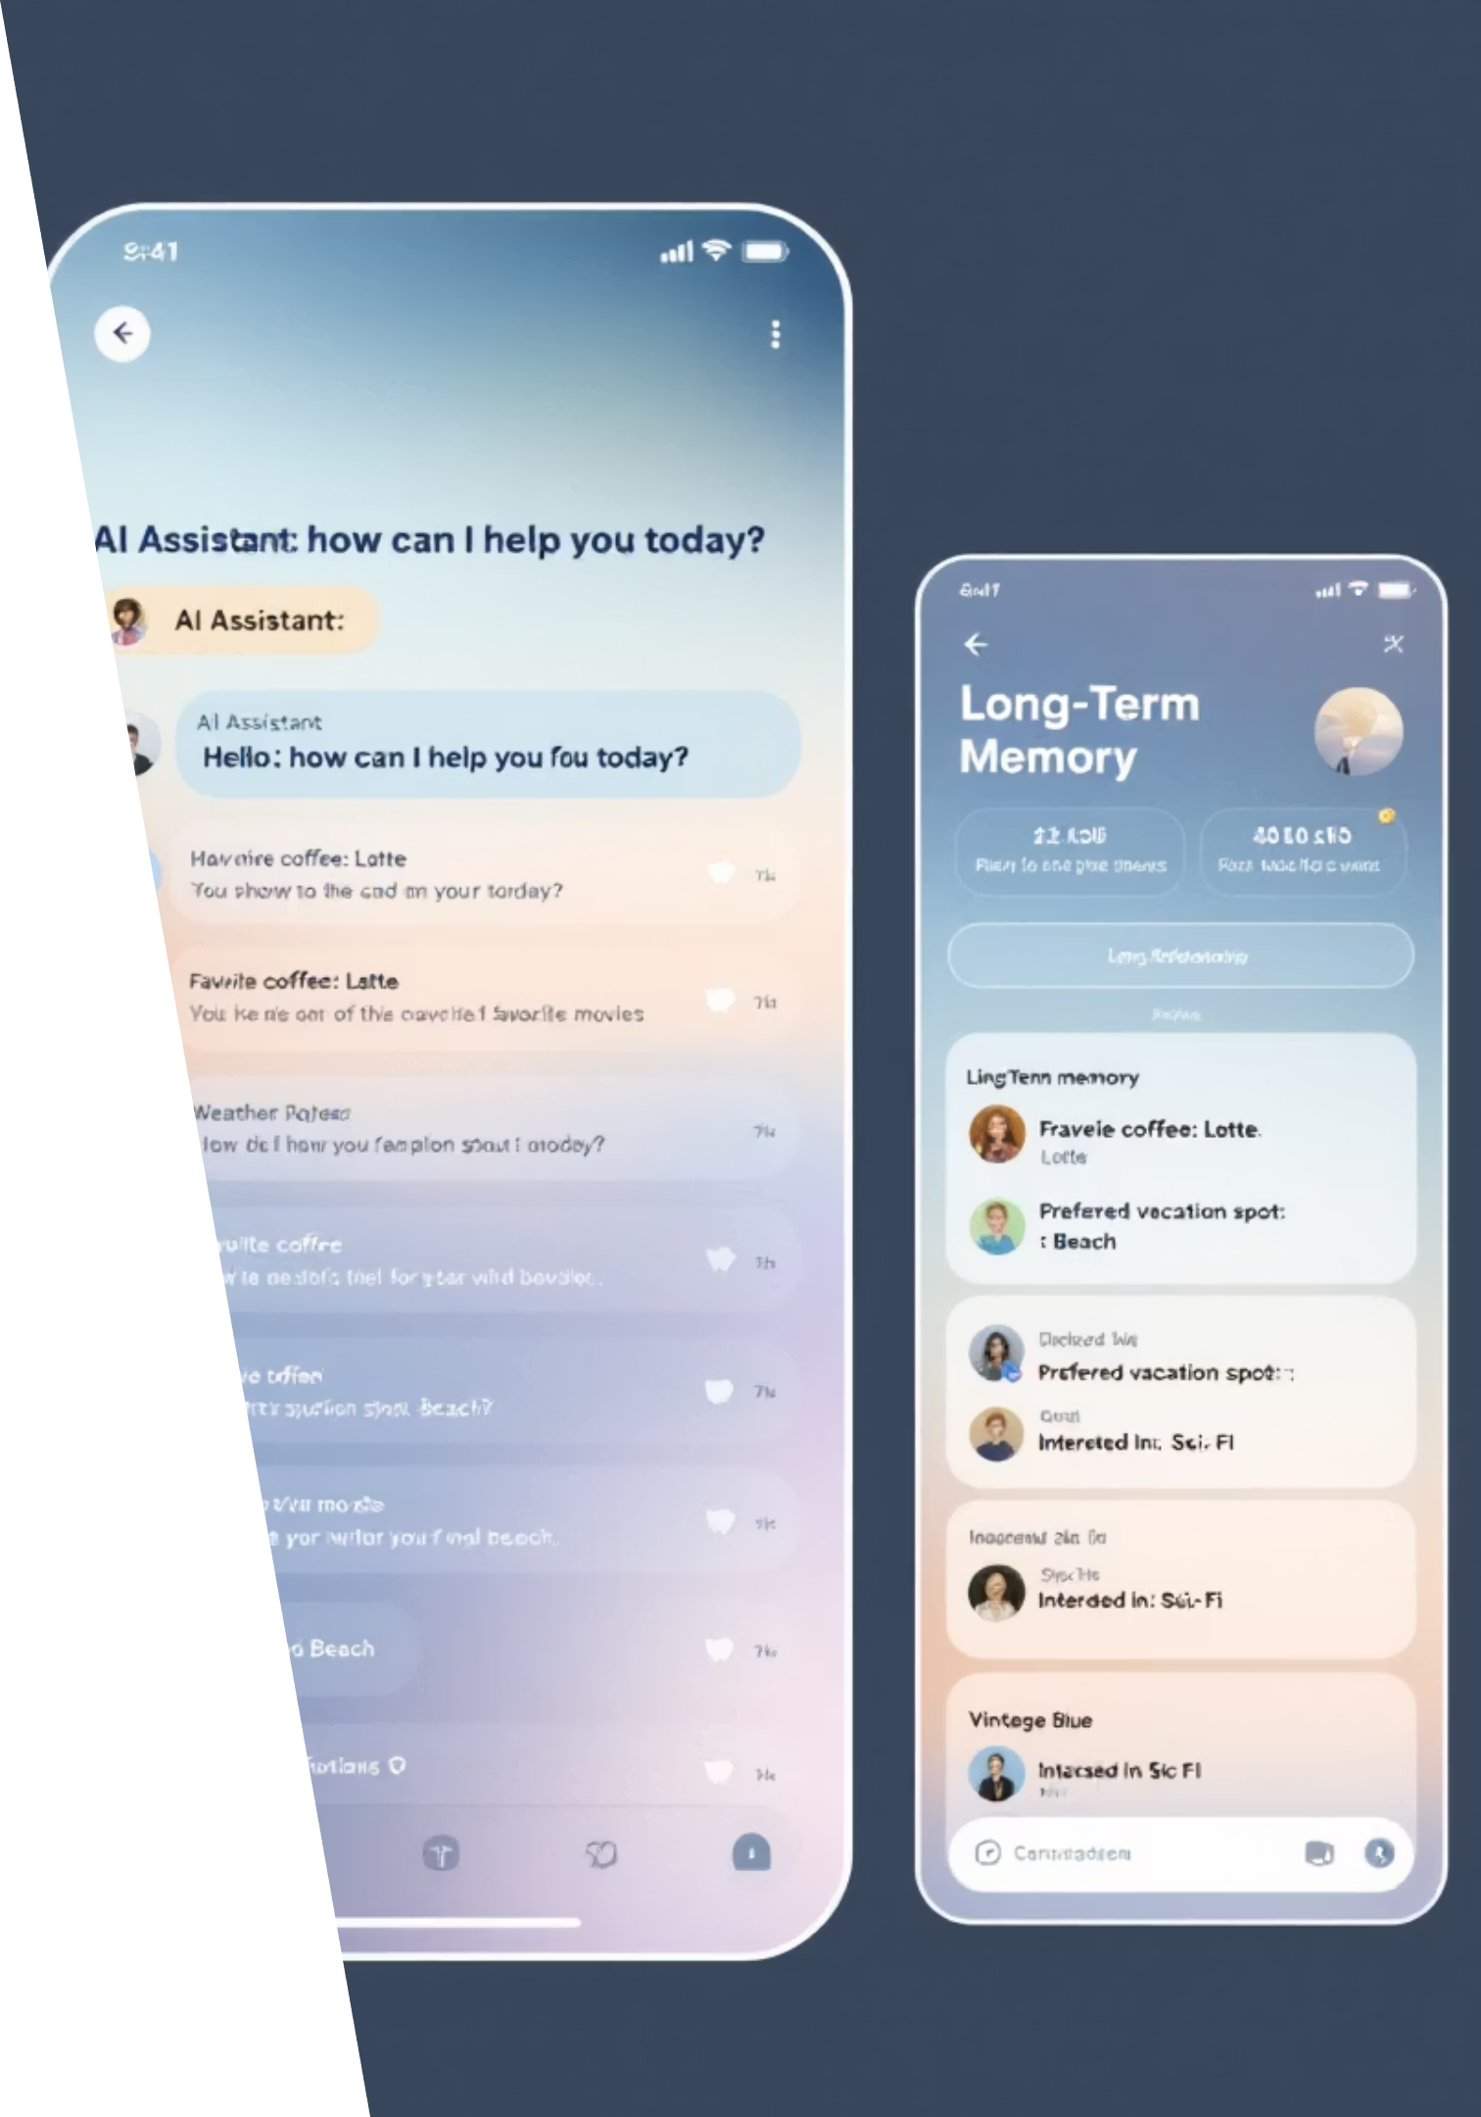
Case Study 2
Advanced Conversational AI
Problem
Implementation
LLMs "hallucinating" and losing track of long conversations
Pinecone for vector embeddings
Solution
Distributed cache for immediate context
Managed long-term memory with user preferences and interaction history
Session state management

Slide 16
Conversational AI Results
Dramatic Improvements
35%
22%
Reduction in irrelevant responses
Multi-turn task completion
Better context awareness and memory
Improved conversation continuity
Key Success Factor: Seamless integration of short-term session context with long-term user preference memory

Slide 17
Implementation Guide

Slide 18
Getting Started
MCP Implementation Strategy
Start Small
Identify 2-3 critical context variables for initial MVP
Infrastructure Integration
Connect with existing data pipelines (Airflow, DataBricks)
Team Collaboration
Foster synergy between data engineering, MLOps, and product teams

Slide 19
Technology Stack
Key Tools & Platforms
Feature Stores
Vector Databases
Streaming Platforms
Feast for feature management and serving
Milvus, Weaviate, Pinecone for semantic search
Confluent Platform, Apache Kafka for real-time data
Storage Solutions
Redis for caching, PostgreSQL for structured data

Slide 20




Best Practices
Common Pitfalls & Solutions
Context Overload
Latency Issues
Start with essential context variables, expand gradually based on performance metrics
Implement caching layers and optimize database queries for real-time applications
Privacy Concerns
Team Alignment
Ensure GDPR compliance and implement data anonymization techniques
Establish clear ownership and communication channels across teams

Slide 21
Implementation Roadmap
Your 90-Day Journey
Week 7-10
Week 1-2
Context capture and management system deployment
Context audit and MVP scope definition
1
2
3
4
Week 3-6
Week 11-12
Infrastructure setup and data pipeline integration
Model integration and performance optimization

Slide 22
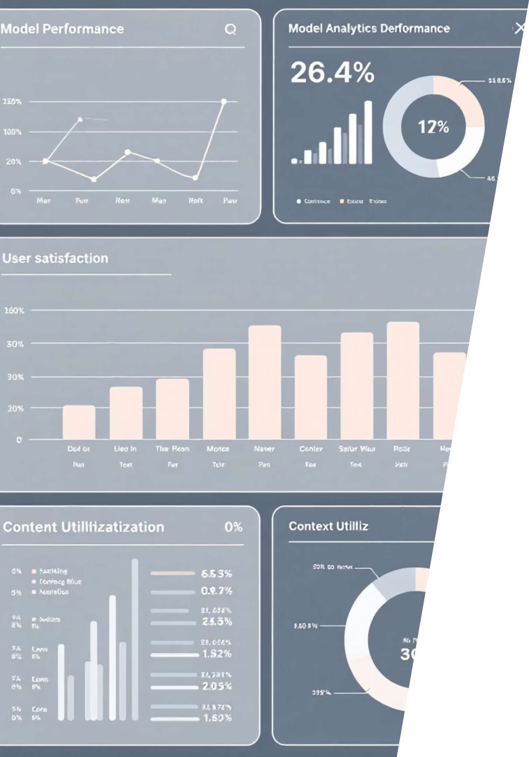
Measuring Success
Key Performance Indicators
↑25%
Model accuracy improvement
Context-aware vs baseline models
↓40%
Error rate reduction
Fewer irrelevant or incorrect outputs
↑30%
User satisfaction increase
More relevant and personalized experiences

Slide 23
Conclusion

Slide 24

Key Takeaways
MCP: Your Path to Intelligent AI
Context is Critical
Systematic Approach
Measurable Impact
Essential for building robust, adaptable AI systems
MCP provides a proven framework for context management
Real-world results show significant performance improvements
Strategic Investment
Context management is an investment in future AI success

Slide 25

Questions & Discussion
Ready to Get Started?
Workshop Resources
Let's discuss your specific use cases and implementation challenges
Implementation checklist
Technology comparison guide
1
Technical Questions
Case study templates
Architecture, tools, integration
Best practices documentation
2
Business Impact
ROI, timelines, resource needs
3
Next Steps
Pilot projects, team formation

Slide 26

Thank You
Let's Build Context-Aware AI Together
Your investment in context management today shapes the intelligent AI systems of tomorrow

